Slide 1
SIGNET Public Report on State-of-the-Art, Achievements and Outlook

Slide 2
SIGNET Objective
The overall objective of SIGNET is to realize the North Star of replacing complex medical workflows and procedures by single-episode personalized, dose-adaptive, precision Magnetic Resonance guided treatments and interventions, improving patient comfort, safety, treatment outcome, and economic viability.
Final status vis-à-vis the objective: All the demonstrators identify the North Star of the aforementioned values. They will bring in substantial sustainability benefits as well.

Slide 3
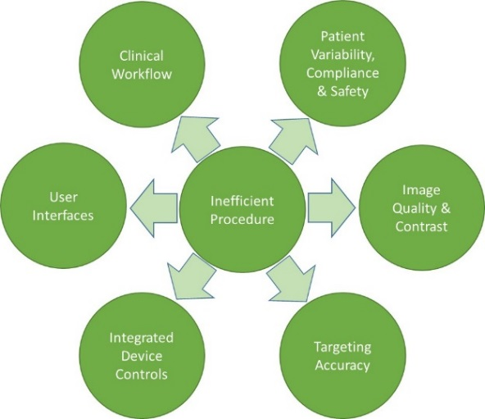
State of the Art
Bottleneck 2: Patient Variability, Compliance & Safety: Several factors influencing different imaging modalities, e.g., acoustic window in Ultrasound, contrast toxicity in CT, electromagnetic compatibility in MR
Bottleneck 1: Clinical Workflow: Need for access to multiple modalities (MR, CT, PET , US) during diagnosis, treatment planning and treatment delivery
Bottleneck 6: User Interfaces: Multiple user interfaces constitute a risk to confuse the clinical user, and potentially lead to workflow inefficiencies or mistakes.
Bottleneck 3: Image Quality & Contrast: MR image quality and contrast issues related to low signal to noise ratio, breathing, fast imaging related challenges etc.
Bottleneck 5: Integrated Device Controls: Multiple interfaces for multiple purposes makes scalability across use cases very difficult
Bottleneck 4: Targeting Accuracy: Geometric accuracy of treatment planning can be compromised by device settings and algorithms.
Current bottlenecks for adoption of image-guided interventional procedures

Slide 4
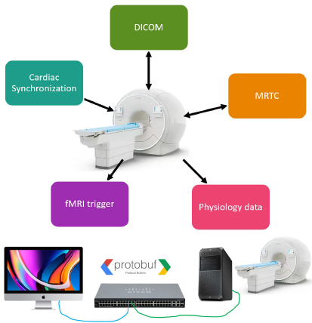
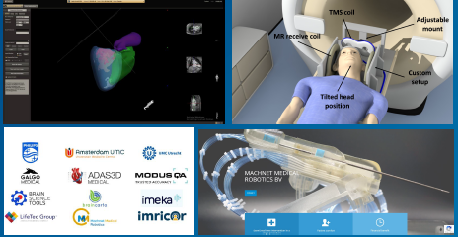
SIGNET Solution and Final Status
Tackling the bottlenecks, SIGNET will develop systems and technologies, AI-enabled products and solutions including the generic Common Open MR Remote Acquisition and Data Exchange interface (COMRADE) interface between scanner and treatment devices ensuring seamless and scalable integration for all innovations, validated for the three use cases
Cardiology (MR-guided electrophysiology (MRgEP)
Oncology (robotics-mediated MR-guided biopsies)
Neurology (fMRI-guided transcranial magnetic stimulation (TMS), fMRI-guided radiation therapy planning (RTP), and laser ablation of epileptic foci).
Final status: Integrated demonstrators showing the effectiveness and efficiency of the digital ecosystem for all the three use cases are ready.

Slide 5
SIGNET: Achieved Innovations
Achieved Target Innovation Areas
Realize the north star of single episode of care with single modality and integrated treatment devices
Improvement of image quality through efficient and effective adoption of breathing guidance, AI technologies etc.
Integrated device controls through single harmonized optimized interface resulting in better accuracy in treatment & Simplified consolidated user interface

Slide 6
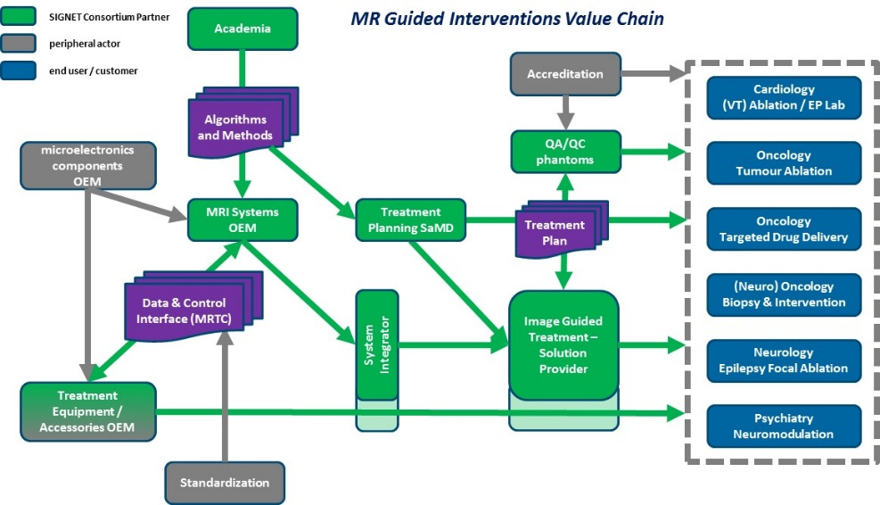
Market value chain

Slide 7
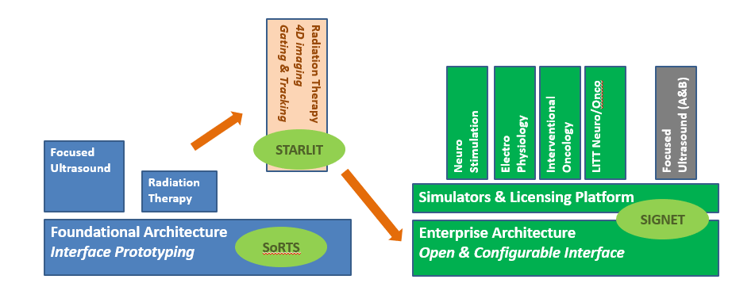
Links and cooperation with other projects (1/2)

Slide 8
Top Technical Achievements vis-à-vis Target Innovation Areas
Target Innovation Areas (TIA):
1: Towards single episode of care with single modality and integrated treatment devices
2: Improvement of image quality through efficient and effective adoption of breathing guidance, AI technologies etc.
3: Integrated device controls through single harmonized optimized interface resulting in better accuracy in treatment & & Simplified consolidated user interface
Bottlenecks:
1: Clinical Workflow
2: Patient Variability, Compliance & Safety
3: Image Quality & Contrast
4: Targeting Accuracy
5: Integrated Device Controls
6: User Interfaces
Top Achievements | Target Innovation Areas | Bottlenecks Addressed
Integrated cardiac ablation (AUMC, LifeTec, Imricor, Adas3D, Philips) | All | All
Breathing guidance and Modus phantom for MR-SIM (UMC Utrecht, Modus QA, Philips) | TIA2 | B2,3,4
Integrated stereotactic neurosurgical planning (partly with simulator) (Galgo, Imeka, Philips) | All | All
Integrated biopsy robot (Machnet, Philips) | All | All
Integrated TMS neuro therapy (BST, Modus QA, Imricor, Philips, Magventure) | All | All

Slide 9
Other Top achievements
Contributions to standardization
  Ecosystem standardization: Common COMRADE interface for treatment and MR system integration with multi-language support (C#, C++, Python)
  Diffusion Tensor Imaging (DTI) Standardization and Harmonization
  Active contribution to different standards (AAMI SM/WG03, ISO/IEC TC 210 etc.)
Many presentations in multiple conferences (ESTRO, ISMRM, MRinRT, SCMR etc.)
Four joint exploitations are being followed up
Good contributions towards sustainability

Slide 10
SIGNET Impact & Outlook
Project goal and objective successfully achieved, meeting the KPIs, resource commitment, scope and quality.
Technological and Clinical Impact
  Realization of the north star of single episode of care with single modality and integrated treatment devices
  Significant improvement of image quality through efficient and effective adoption of breathing guidance, AI technologies etc.
  Publicly exploitable results through multiple papers and presentations, 3D cardiac visualization software
Commercial Exploitation Impact
  Deployment of different business models from traditional to pay-per-click
  Securing intellectual property through 1 patent submission and 4 invention disclosures.
  4 joint exploitations opportunities up besides solid exploitation opportunities
  Good contributions towards sustainability

Slide 11
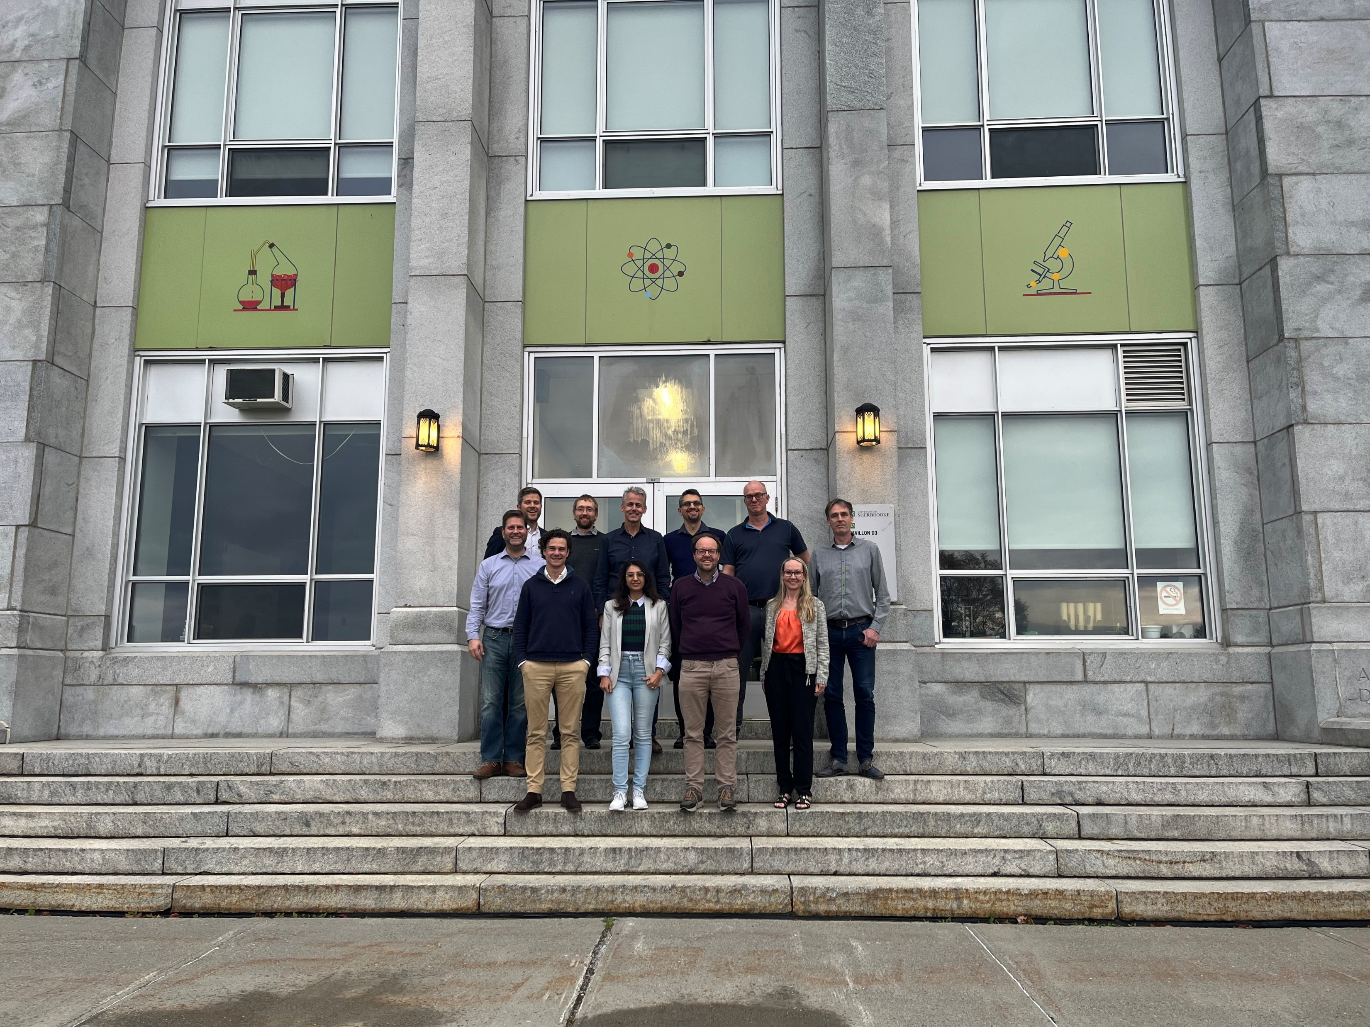
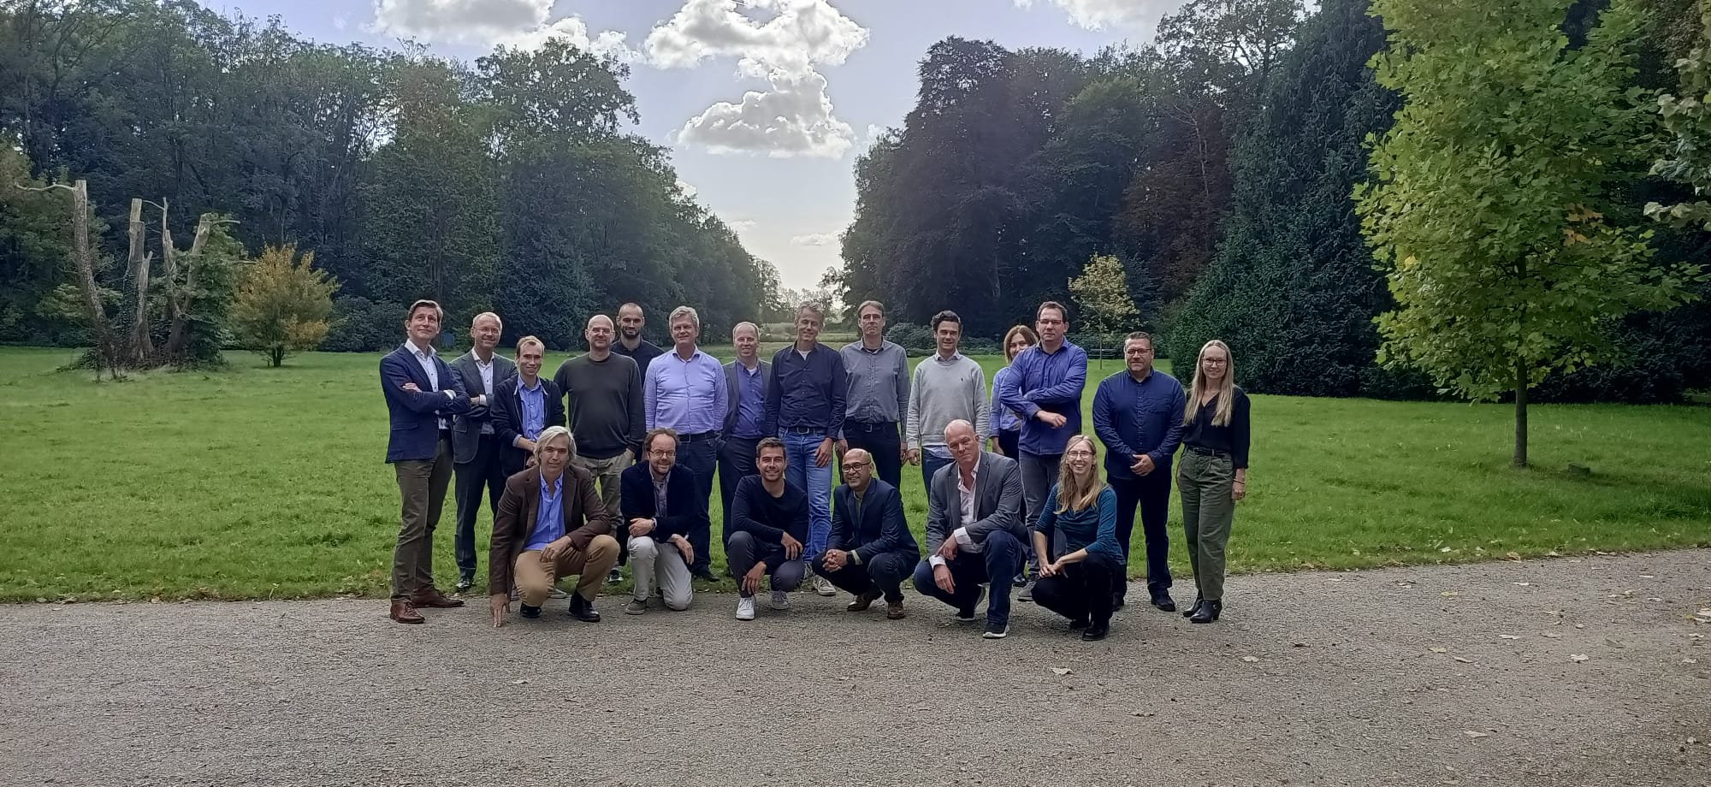
Thank you

