Slide 1
VISION
Virtual Integrated Supply-chain Improvement with Optimised Networking
Kick-off meeting
23rd September 2025

Slide 2
Agenda
Welcome and introductions
Who we are and what we bring to the project
National funding status’
ITEA level admin
PCA
Project management and Communications plan
High level plan review
Plan activities for the next quarter
Date of next meeting
AOB

Slide 3
Welcome and Introductions

Slide 4
Who we are and what we bring to the project
Discussion points: Project website and logo

Slide 5
Funding Status
UK
  Funding was approved in 2024, project started on 01/04/25
Türkiye
  Funding approved,
Republic of Korea
  Funding approved, completing the steps to receive the funding. Project started on 01/07/25
Spain
  Withdrawn from the consortium
Discussion point
  Who the representatives from each organisation are and update the contact sheet to reflect discussions

Slide 6
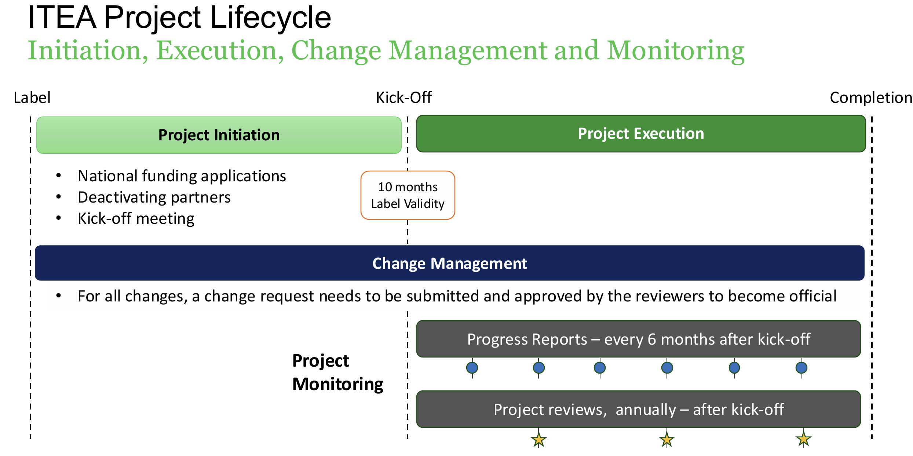
ITEA level admin

Slide 7
PCA
Awaiting signatures from:
  Innova

Slide 8
Communications and project management
Discussion points
  How we will report progress
  The tools we will use
  Establish consortium meetings and the frequency
  Communication channels
  PCR ongoing with ITEA – new one to be raised due to the departure of IASOL from the consortium

Slide 9
Plan review
Project objectives
Gantt chart, WP, task and deliverable ownership
Risk register
ITEA Project portal
Gantt.mpp
Risk register.xlsx

Slide 10
Planning of activities going forward
UK:
EMS: Project Management
Digital Twins
University of Loughborough:
Türkiye:
Alpata: Digital Twin Supply Chain Management for Aviation
Innova:
Net zero policy creation. AR based cargo loading system.
Netcad: Transport and Mining Digital Twins
Republic of Korea:
MetaReal:
Prototype development of UWB anchor and tag
SIMSREALITY:
Early-stage AR application development
Hanshin University:
Optimal AI algorithm survey for UWB RTLS positioning error compensation

Slide 11
DONM/AOB
Date of next meeting
  Doodle poll to establish a regular day and timing

