Slide 1
D5.4 – Integrate virtual manikin simulation framework in layout optimization
Raad Salman (FCC)

Slide 2
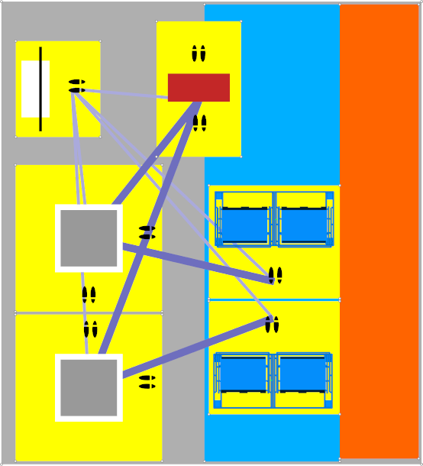
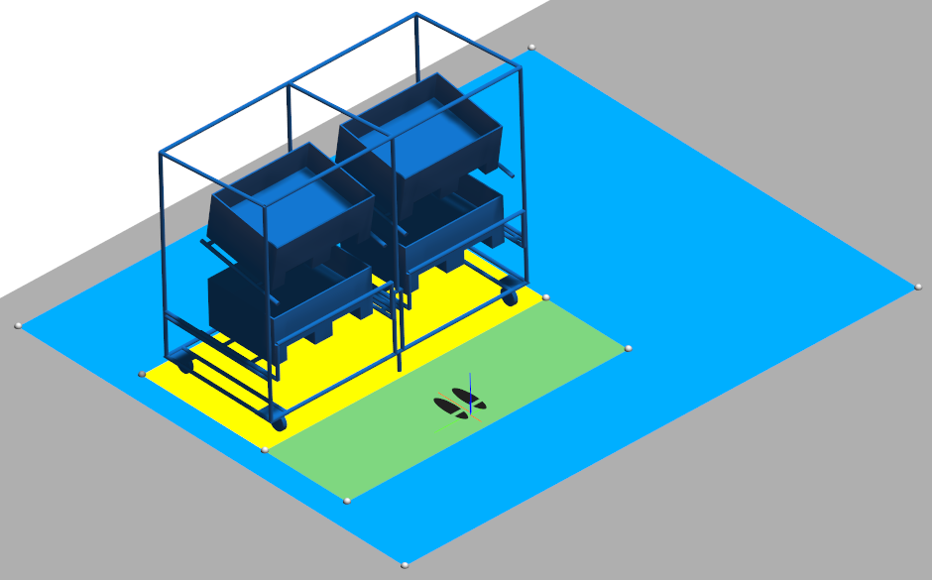
Problem definition
Problem is defined as placing a predetermined number of resources on a bounded plane (gray region)
The total available space can be limited and split into subregions where subsets of the resources are constrained to be placed (blue regions)
Spatial constraints are defined around resources by simple polygons (yellow regions)
We want to include DHM measures such as ergonomics and true walking distance in the optimization loop

Slide 3
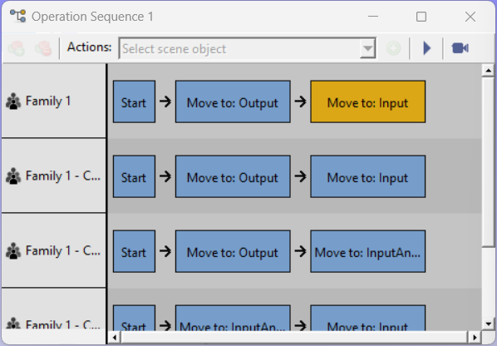
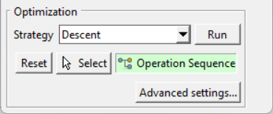
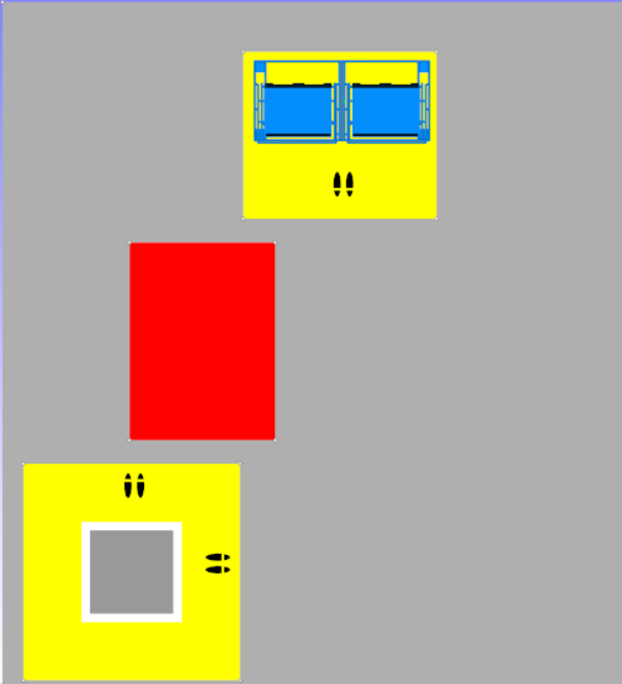
Adding sequences
We allow the specification of sequences as an optimization objective
The distance between objects will now be computed to the specific access points instead of shortest distance between resource center points
The distance will also take collision with 3D models and forbidden regions into account, and a clearance distance to obstacles can be specified if desired
After a layout is generated, the same specified sequences can be evaluated more exactly

Slide 4
Adding sequences
This will give a more realistic measure of how good a layout is in terms of accessibility and will prevent layouts where access point are blocked by obstacles to be generated
One limitation is that the exact kinematics and shape of the human is not taken into account in the objective. For example, excessive turning or tight walks should be considered undesirable
However, exact computations of these measures would take an infeasible amount of time so this approximation could generate layouts that can be refined further with cumbersome computations

Slide 5
Future work
Improve the optimization routines to adapt to this objective function
Automate the use of true DHM walking distance and ergonomic score
Optimize the layout of shelf/material placement (height of placement) in order to better improve ergonomics in the work place

