Slide 1
User guide of Crown program on Gränges server (for end user)
Chunhui Luo
2024-03-29
1

Slide 2
Contents
Introduction of Crown4 program
Rolling process of plate at Gränges
Important signals from Gränges database (omitted)
Modify input data after getting signals from Gränges database (omitted)
Step-by-step guide on Gränges server
Tips for user
2

Slide 3
1. Introduction of Crown4 program
3

Slide 4
Crown 4
CROWN4 is a program for simulation of plate and strip rolling in four high rolling mills. The program contains modules for prediction of rolling force and plate strip temperature and calculation of thermal expansion of work rolls, work roll wear and elastic deformation of the mill under the rolling load.
The program outputs are plate or strip thickness profile and flatness, work roll diameter profile as a result of thermal expansion and wear and contact forces between rolls and plate or strip.
The program also contains a module for calculation of pass schedules in hot rolling mills.
4

Slide 5
Program modules
WASPN thickness profile and flatness of rolled plate/strip.
NTREX thermal expansion of work roll.
WEAR2 wear of work roll.
SLABTEMP temperature of rolled plate/strip.
Used
Optional for use
5

Slide 6
Calculation sequence
Repeated calculations for multiple passes
Pause time -
Thermal crown in work rolls
Plate/strip temperature
Rolling time –
Plate/strip thickness profile and flatness
Thermal crown in work rolls
Plate/strip temperature
Roll wear
6

Slide 7
Crown4 files
Input data
NAME.cin
NAME.csh
CROWN4
Output data
NAME.out
NAME.sum
NAME.err
NAME.aux
7

Slide 8
Input files
CROWN4 mainly uses two input files: NAME.CIN and NAME.CSH
  NAME.cin is used for initiation input of data that are not changed through the calculation. The file is only read once in the beginning of the simulation.
  NAME.csh is used to input data that is changed during the simulation. Data can change from strip to strip, from pass to pass or during pause time. New data is read for every new plate/strip or every new pass depending on the rolling mill configuration. For a non-reversible tandem mill data is given for all passes at a time but for a reversible mill data is given pass for pass individually.
For Gränges, two group of input data are prepared as template:
  For Mill 2051: GMill2051.cin and GMill2051.csh
  For Mill 2071: GMill2071.cin and GMill2071.csh
8

Slide 9
Output files
CROWN4 output is written in five text files. The output files are overwritten when a new calculation for the same input files are started. The file name before the extension will be the same as for the input file.
  NAME.out is the normal output file containing results from CROWN4 calculation. Data is presented in tables with column separations with separator ‘,’ suited for Excel plot program if the extension name is changed to ‘csv’.
  NAME.tim containing temperature –time multiple-column data.
  NAME.err containing general information about the calculation, the program used, pass number, plate/strip number and how reading of input data proceeded. Error messages written to the screen during calculation is also written to this file.
  NAME.aux containing simplified data regarding roll thermal expansion and wear and exit strip crown and flatness.
  NAME.sum containing important result data for each pass.
9

Slide 10
2. Rolling process of plate at Gränges
10

Slide 11
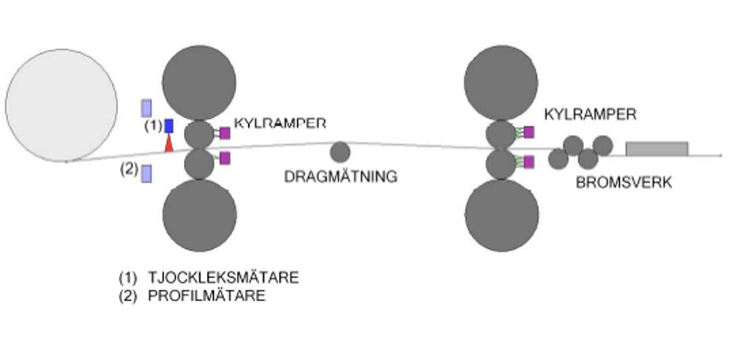
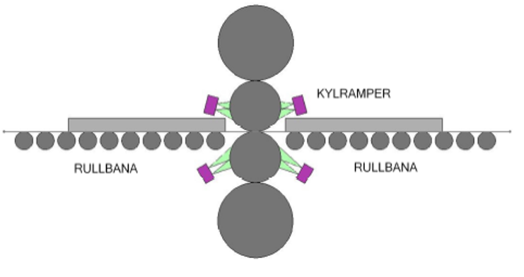
Rolling process of plate at Gränges
Reserving rolling mill 2051
Tandem rolling mill 2071
Cooling before rolling
Time: ~60 seconds
Surface temperature: 500 -> 495 °C
Rolling (2051)
Thickness: 590 -> 18 mm
Temperature: 500 -> 440 °C
Pass number: ~ 25
Intermediate pass cooling time: 2-10 seconds
Cooling rolling
Time: ? seconds
Temperature: 440 -> 400? °C
Rolling (2071)
Thickness: 18 -> 8 -> 3.7 mm
Temperature: 400? -> 350 °C
Stand number: 2
11

Slide 12
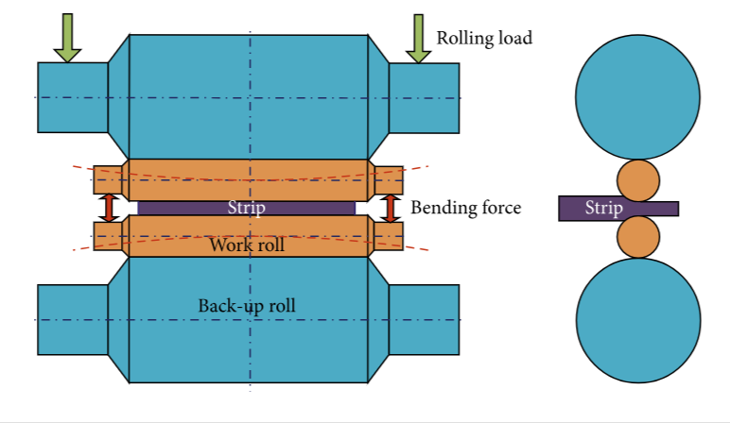
The schematic diagram of hydraulic roll bending technique at Mill 2071
Work roll bending forces are applied, using hydraulic cylinders, to the work roll shafts located at both roll ends.
12

Slide 13
3. Important signals from Gränges database (omitted)
13

Slide 14
4. Modify input data after getting signals from Gränges database (omitted)
14

Slide 15
5. Step-by-step guide on Gränges server
Read data from database
Read data from existing input
15

Slide 16
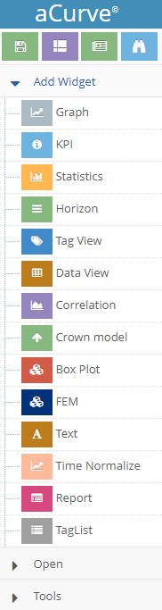
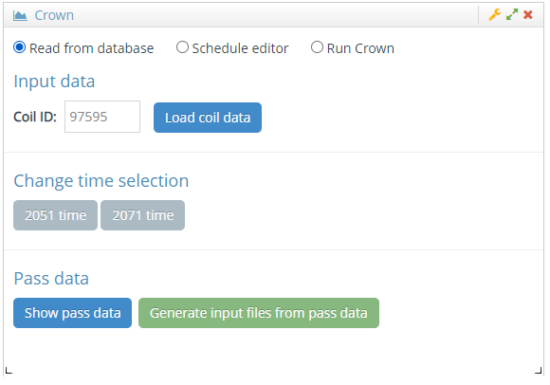
I. Step-by-step guide (read data from database) - Select Crown model
3
2
Type Coil ID
1
16

Slide 17
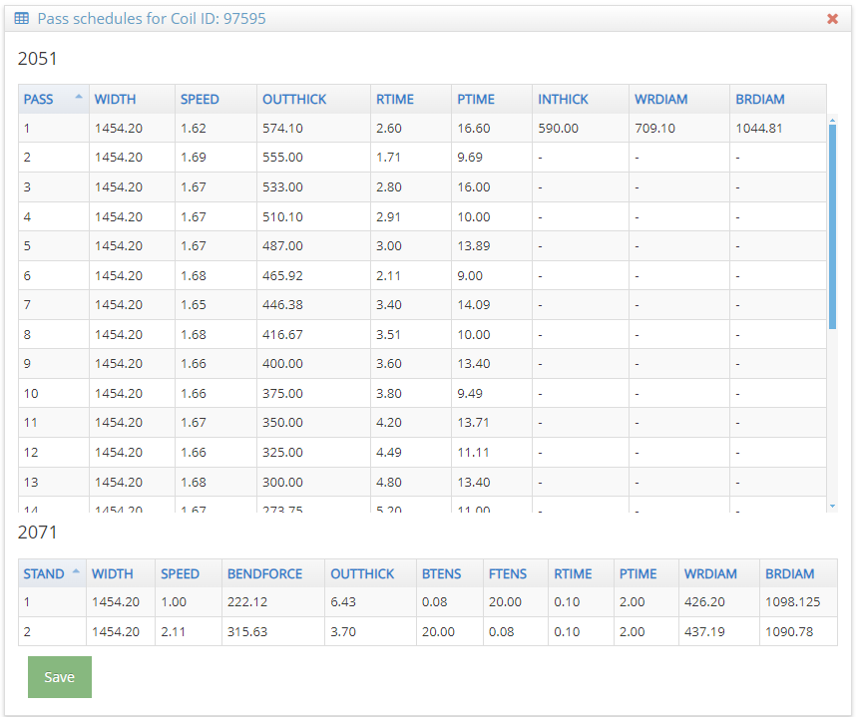
I. Step-by-step guide (read data from database) - Show pass data
5
4
17

Slide 18
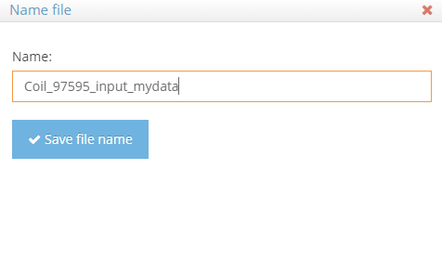
I. Step-by-step guide (read data from database) - Generate input files and give a name
7
Modify the pre-designed name
8
6
18

Slide 19
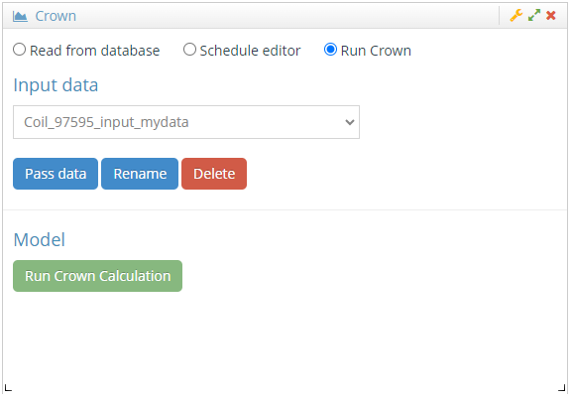
I. Step-by-step guide (read data from database) - Run Crown Calculation
Note: this is the name that you give.
9
19

Slide 20
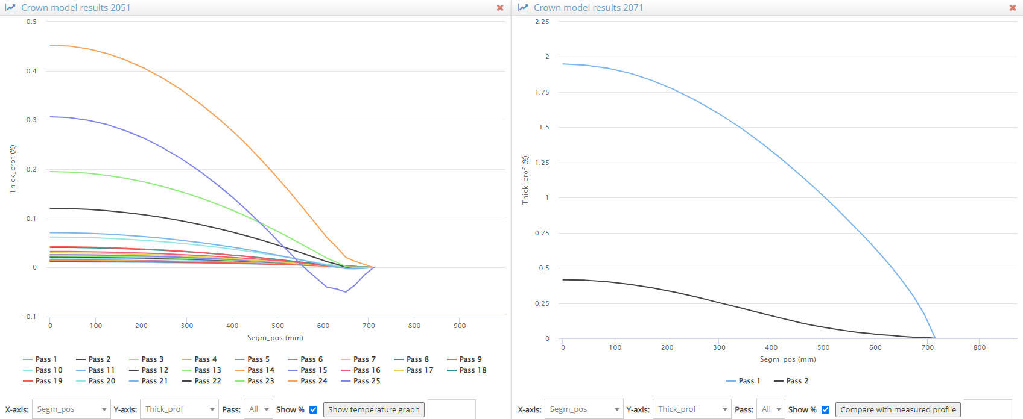
I. Step-by-step guide (read data from database) - Results after running Crown
Thickness profiles (%) for 2051
Thickness profiles (%) for 2071
20

Slide 21
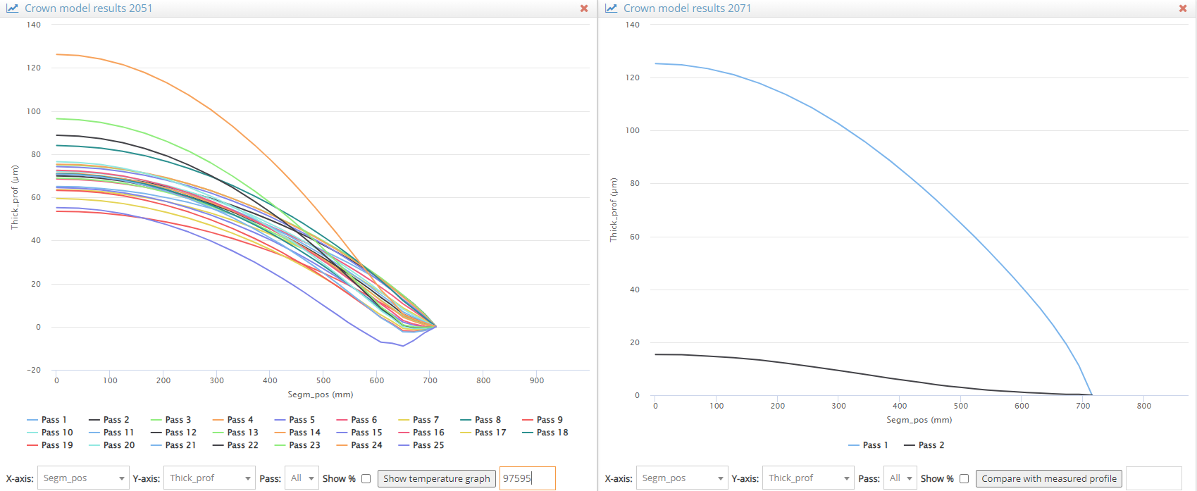
I. Step-by-step guide (read data from database) - Show thickness profile in μm unit
10
uncheck
12
Type Coil ID: 97595
11
uncheck
13
show temperature history for 2051
21

Slide 22
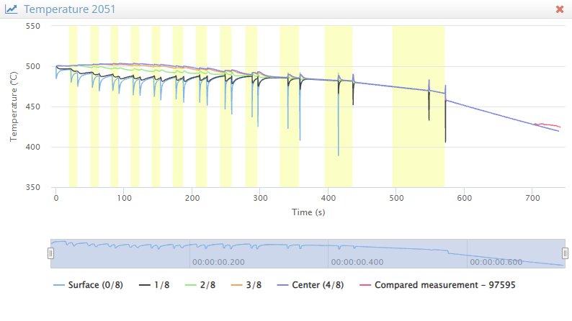
I. Step-by-step guide (read data from database) - Show temperature histories at different thickness locations for 2051
22

Slide 23
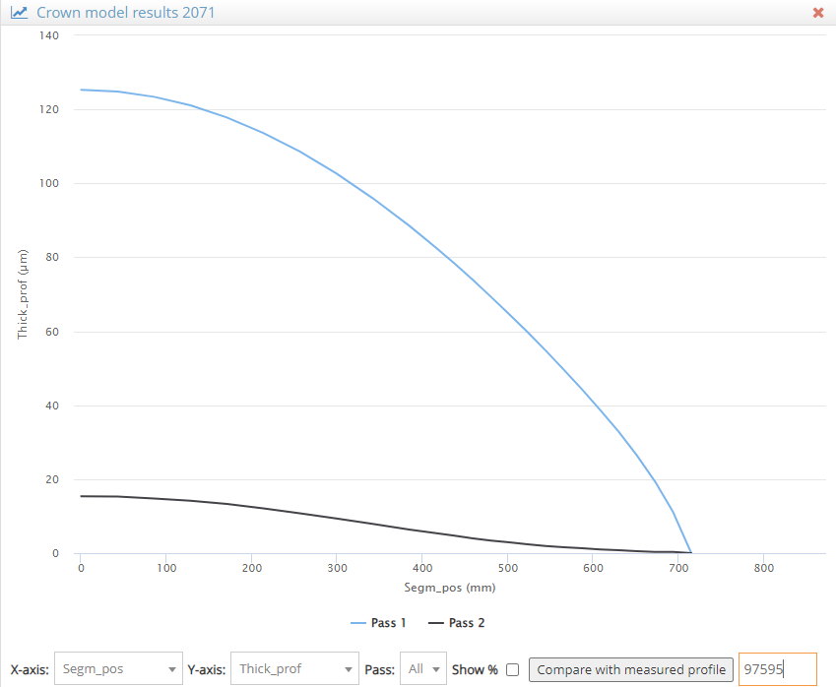
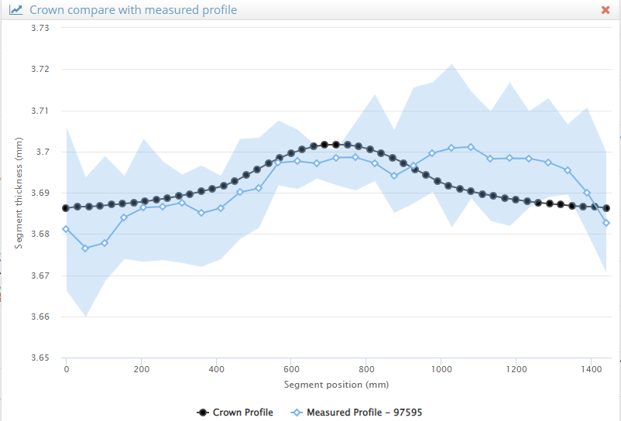
I. Step-by-step guide (read data from database) - Compare calculated profile with measured one
14
Type Coil ID: 97595
15
Compare with measured
23

Slide 24
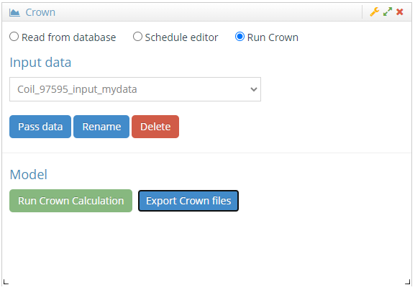
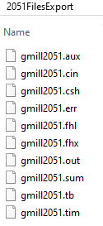
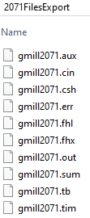
I. Step-by-step guide (read data from database) - Export Crown files to server or your local computer
Coil_97595_input_mydata_date-time.zip
16
Export Crown files to server or your local computer
24

Slide 25
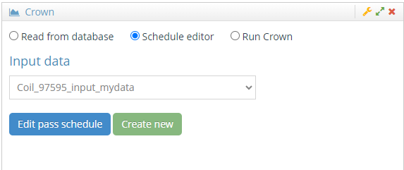
II. Step-by-step guide (read data from database) - Select Crown model / select input
2
3
Select an input
1
4
25

Slide 26
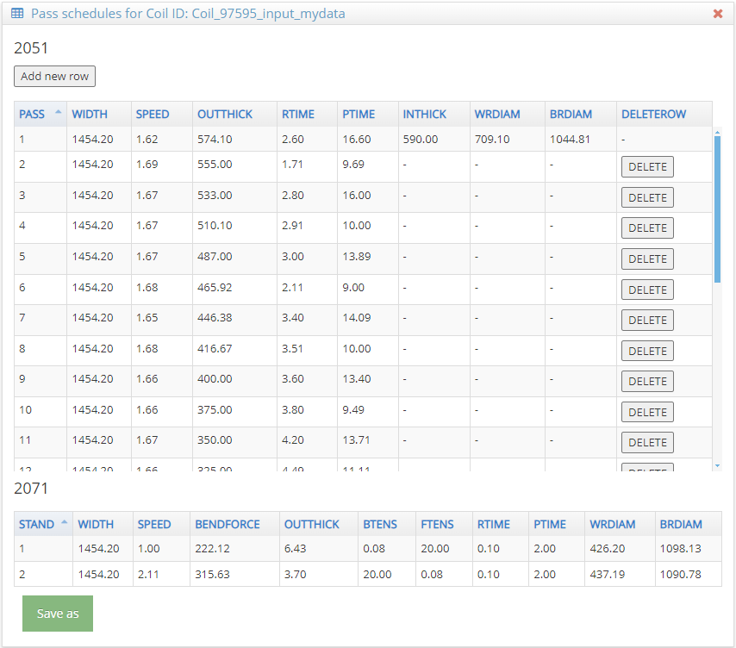
II. Step-by-step guide (read data from database) - Show pass schedule
5
26

Slide 27
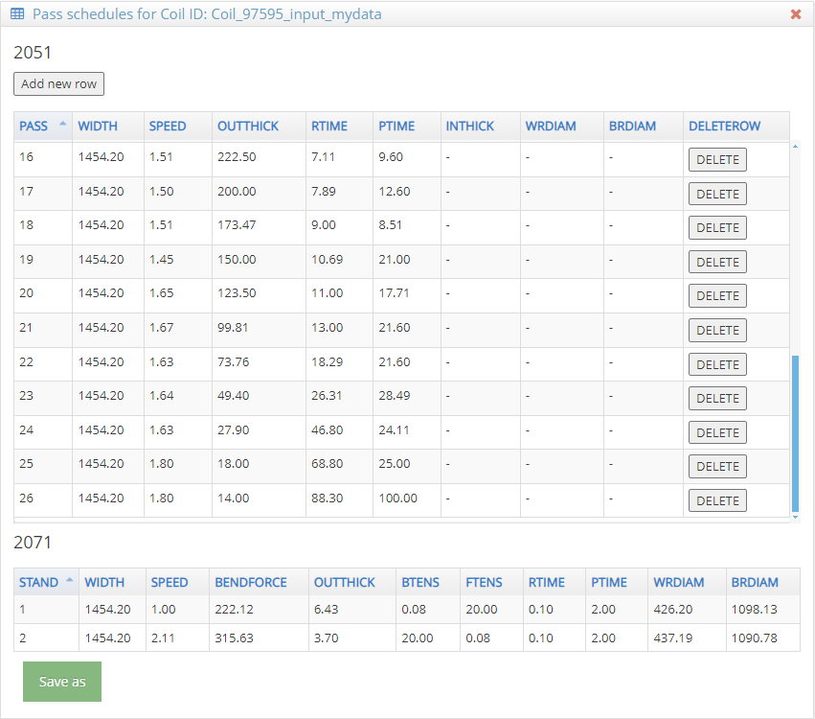
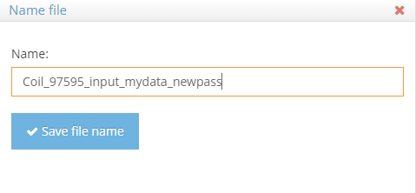
II. Step-by-step guide (read data from database) - Add a new Pass
8
Type name
9
6
Type values
7
27

Slide 28
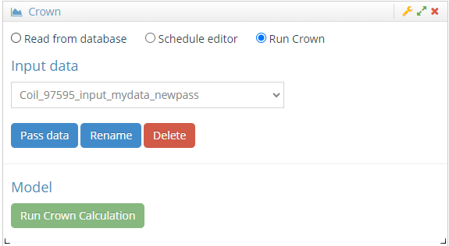
II. Step-by-step guide (read data from database) - Run Crown Calculation
Note: this is the name that you give.
10
28

Slide 29
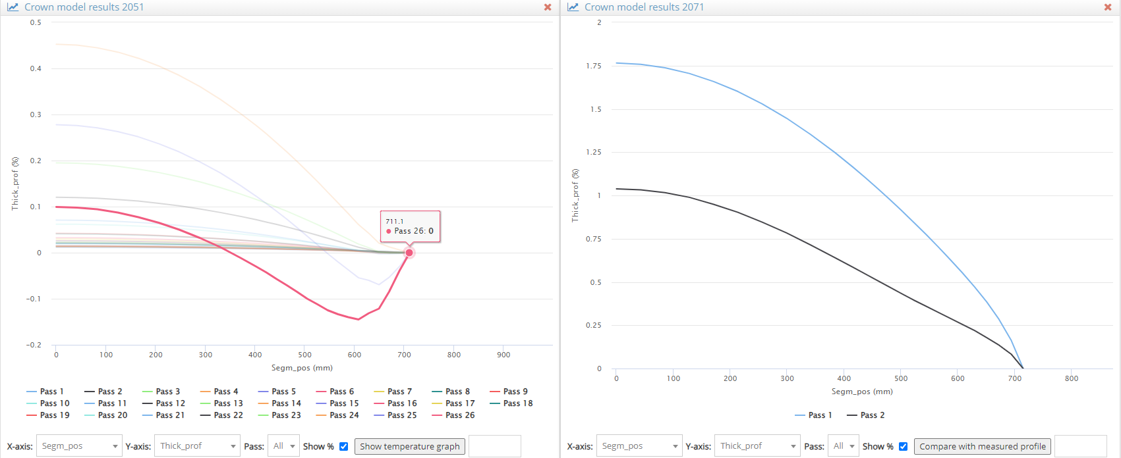
II. Step-by-step guide (read data from database) - Results after running Crown
Thickness profiles (%) for 2051
Thickness profiles (%) for 2071
No plotting due to bug in Cown4 code.
29

