Slide 1
ACDC
Project Overview
Patrick Schwartz, Thomson Video Networks
Final Project review, November 21st 2012, Luxembourg

Slide 2
Outline
Introduction & Relevance
  Purpose and Rationale of ACDC project
  State of the Art and Expected Results
  Achieved Results & Innovations
Management Overview
  Duration / Funding
  Consortium & Manpower
  Project organization and meetings
Project structure
Deliverables status

Slide 3

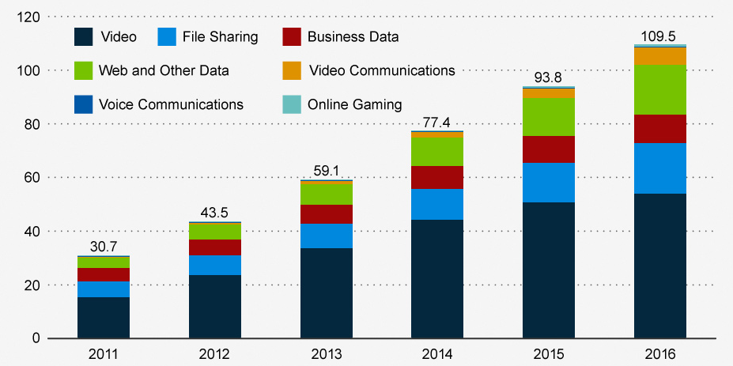

Introduction & Relevance
Purpose and Rationale of the project
Video will represent
Half of Internet Traffic in 2015 *
Processing,
Transcoding, Storage
Personalization
IP Traffic per month
(in Exabyte)
« TV from the Cloud »
New Business Model
« Pay as you go for what you use »
Search
Recommendation
Filtering
* Source: Cisco VNI 2012
Notes:
First statement coming from CISCO report 2012 is that video will represent 50% of the overall Internet Traffic in 2015.
So several tracks could be considered to avoid bottlenecks and overloads in IT infrastructures. One of them is to considerer that TV could be processed and coming from the Cloud with processing, transcoding, storage and personalization distributed in Cloud Computing nodes, but with also Search, recommendation and content filtering using Cloud.
This is the approach taken in ACDC and we are convinced than a new business model will take place:
“Pay as you go for what you use”

Slide 4
Introduction & Relevance
Purpose and Rationale of the project
Context and Issues
The ACDC approach
Fast High Quality Broadcast delivery from Content providers to Broadcasters / Operators
Secured File Based Workflow
Many Sizes / Resolutions
Heterogeneous Networks / Devices
Cloud allows Mutualization
Huge amount of video content
to process / store and deliver
Cloud allows extra capacity at peaks demands
Notes:
On theses two slides we are going to see what are the issues to solve and how ACDC could answer

Slide 5
Introduction & Relevance
Purpose and Rationale of the project
Context and Issues
The ACDC approach
Reduce progressively Capex and move to Opex business model
With Cloud « Pay as you go for what you use »
Fit with Fluctuating Business Growth
Cloud allows Scalability
Easy Search and Fast recommendations
Implement Semantic Technologies on top of the Cloud infrastructure
ACDC: « a new Complete Eco-System thanks to Cloud »

Slide 6
Introduction & Relevance
State of the Art and Expected Results
State of the art
Growing complexity of encoding algorithms to increase video resolution and to decrease the network bandwidth
Similar contents delivered on multiple heterogeneous networks
Semantic technologies, almost unexplored outside the web, could allow better content recommendations with higher personalization
Expected Results
New content delivery method based on virtualization of running processes over distributed cloud networks
  Offer to business clients new perspectives in multimedia content delivery allowing CAPEX/OPEX optimization
  « Cloud computing » will allow a massive parallelism for these new challenges
Offer to Consumer end-users new enhanced and personalized applications and services
Notes:
State of the Art
Real Time Video compression had to face a lot of challenges due to growing complexity of encoding algorithms allowing to increase video resolution and to decrease the network required bandwidth
Operators must now deliver several similar contents on multiple heterogeneous networks (Cable, Satellite, IPTV, Mobile TV, WebTV)
The application of semantic technologies is almost inexplored outside the web domain and will allow better content recommendations with higher personalization
« Cloud computing », until now, dedicated to « pure IT services » will allow a massive parralelism for these new challenges
Expected Results
Validation of a new content delivery method based on virtualization of running processes over distributed cloud networks through field trials using real networks
To offer to business clients such as broadcasters, Content delivery providers, Telecom operators or Internet service providers new kind of infrastructures and services allowing new perspectives in multimedia content delivery and therefore CAPEX/OPEX optimization
To offer to Consumer end-users new enhanced applications and services offering personalization, contextualization and new advanced Electronic service guides which will constitute added value services offered by the operators to these end-users

Slide 7
Introduction & Relevance
Achieved Results and Innovations
  Use of « Cloud Computing » concept for multimedia context
  Adaptation of « Cloud Computing » to multimedia contents with efficient load-balancing system for Cloud resource allocation
  Scalable Content Processing and Contextual adaptation
SaaS* model allowing use of hosted contents and semantic information's for contextual services
  Service platform implementation based on SaaS model for different processes such as transcoding, logo insertion, semantic recommendations
  Study of advanced video processing (3D coding) and new cloud based services (HbbTV) on Cloud architecture
  And significant “Fast” Exploitation perpectives
* SaaS: Software as a Service
Notes:
Achieved Results
Automatic and scalable content processing for content input, adaptation and storage
Service platform implementation allowing SaaS model for different processes such as transcoding, logo insertion, semantic recommendations
Study of advanced video processing (3D coding) and new cloud based services (HbbTV) on Cloud architecture
Innovations
Adapt « Cloud Computing » to multimedia content applications and find efficient load-balancing system for Cloud resource allocation
Allow scalable Content Processing (ingest, adaptation, storage,…) and Contextual adaptation
Develop a service platform based on SaaS model allowing use of hosted contents and semantic information's for contextual services

Slide 8
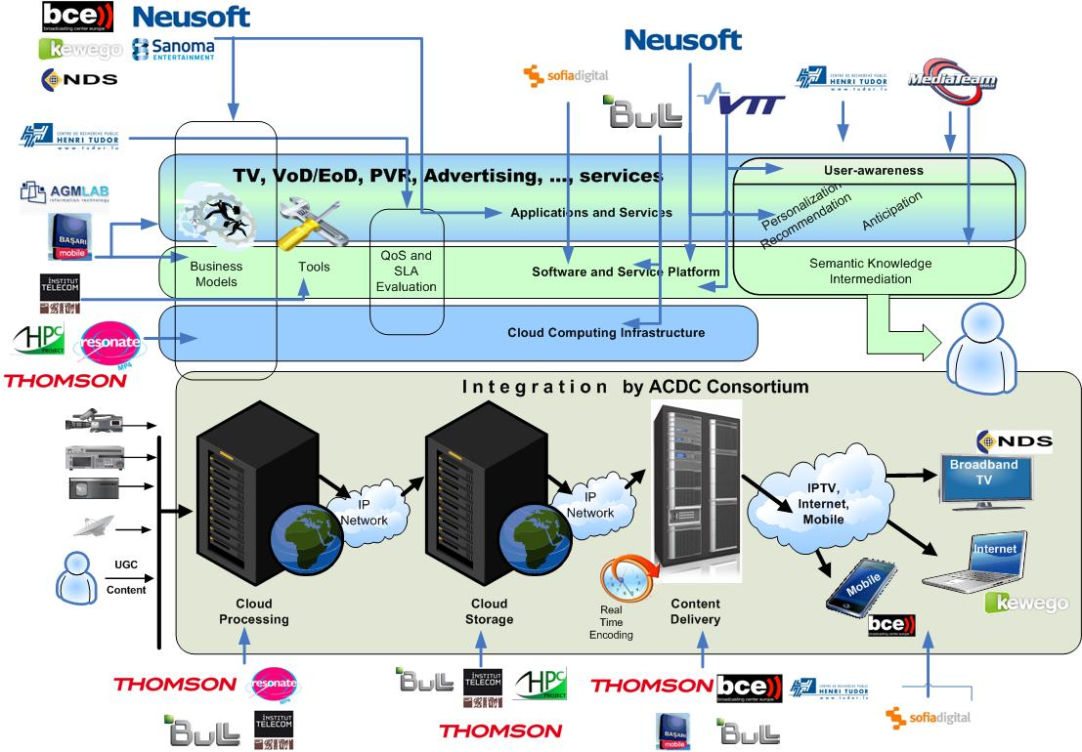
Introduction & Relevance
The ACDC System Architecture
Notes:
The complete End-to-End system architecture showing the complementary of partners to provide a complete eco-system

Slide 9
Management Overview
Duration / Funding
Program: ITEA2 09008.
Duration: 30 Months
  Start: 1st June 2010
  End: 30th November 2012
Funding situation
  France: confirmed in June 2010, notification end of December 2010
  Finland: notification June 2010
  Luxembourg: notification April 2011
  Turkey: notification January 2011
→ Kick-off beginning June 2010. Due to late notification 3 months delay on first deliverables, but no impact on the overall planning

Slide 10
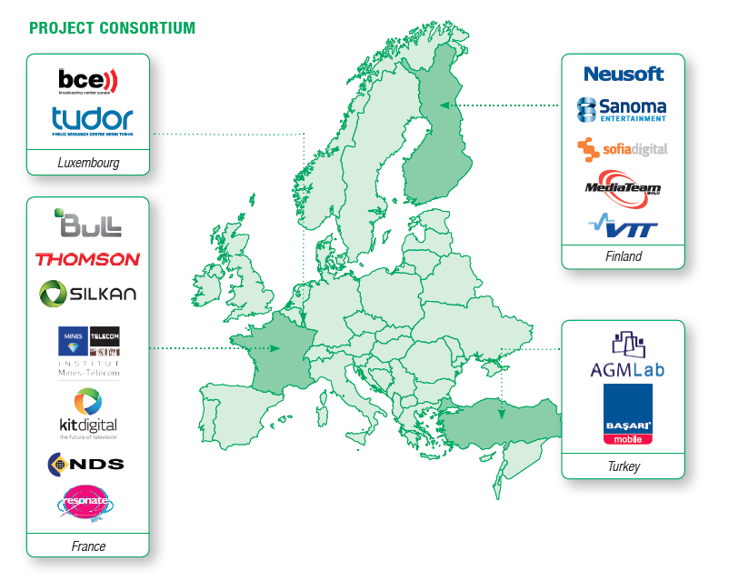
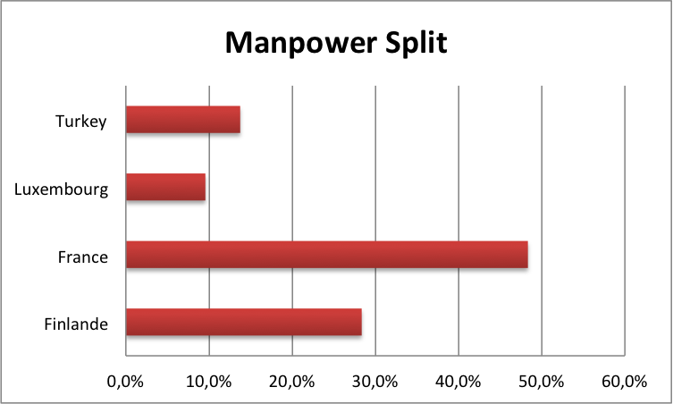
Management Overview
Consortium / Key Figures
16 partners from 4 countries
Duration 2,5 years
 | Planned | Spent
Costs (K€) | 13 794 | 13 708
Manpower (P/Y) | 121,85 | 121,09
Notes:
Manpower and costs in line with the planned budget

Slide 11
Management Overview
Project Organization and meetings
Three levels of project management:
  Project coordination → Thomson Video Networks
  Technical coordination → VTT
  Marketing coordination → NDS
  Project organization based on project planning, deliverable tracking sheet, project handbook
9 plenary meetings:
  Espoo Finland, Paris France, Espoo Finland, Ankara Turkey, Rovaniemi Finland, Paris France, Istanbul Turkey, Espoo Finland, Issy les Moulineaux France
Monthly Regular WP meetings and conference calls including WP’s alignment meetings and Master Use Cases definition
4 progress reports, 2 change requests
2 project reviews in Luxembourg

Slide 12
Management Overview
Project Evolutions: despite PY  no significant impact on the project
Initial Consortium FPP v1.0 - 09/2009 | 17 partners / 181 PY / 24 deliverables
Change Request 1 FPP v2.0 Submission: 03-2011 Approval: 04-2011 | • Withdrawal of SRDC, Turkey due to lack of funding Withdrawal of NOKIA, Finland due to strategy change • Budget reduction about 20% for French partners • 3 months delay on first deliverables due to late notification of contracts • Reduction of number of scenarios demonstrated in WP4 • Introduction of new Finnish partner LEIKI and Turkish partner BASARI Mobile ➡ 17 partners and 137 PY - 25 deliverables
Change Request 2 FPP v3.0 Submission: 06-2012 Approval: 07-2012 | Withdrawal of Leiki, Finland due to unavailable resources and no funding Minor budget reduction for Sanoma and transfer from Sanoma Entertainment division to Sanoma News entity Few modification of activities for Tudor ➡ 16 partners and 122 PY - 28 deliverables
Notes:
Despite Budget Reduction no significant impact on project goals. Just less demonstrated use-cases

Slide 13
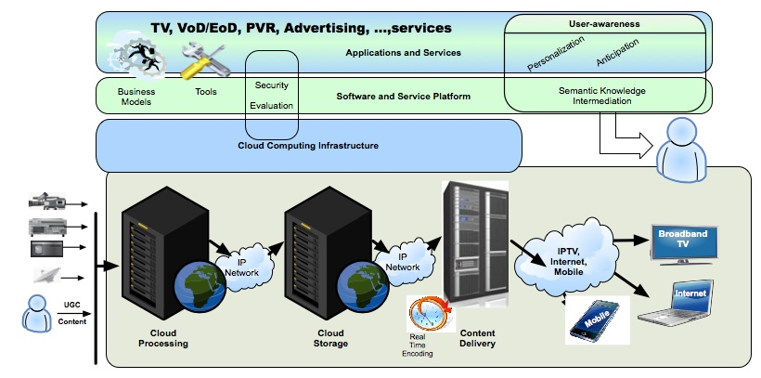
Generic Architecture and Link to WP’s breakdown
WP4
WP1
End-to-End Applications
Use Cases
Business
Models
Architectures
WP3
WP2WP2W

Slide 14





Project Structure
WP4: Integration
&
Demonstrations
WP2: Cloud Computing
Infrastructure
WP1:
Use cases,
Business Models,
Architectures
WP3: Software and
Service Platform
WP5:
Management, Exploitation and Dissemination

Slide 15
Project Methodology
WP4: Demonstrations
WP1: Use Cases, Business Models, Architectures
WP2: Cloud Computing Infrastructure
D4.3: Evaluation Reports
D2.1, D2.2: Tools,
Sizing & Specifications
D2.3: Cloud Processing
& Storage implementation
D4.2: Project Demonstrations
D1.3: Service Architecture
& Requirements
WP3: Software & Service Platform
D1.2: Business Models
D3.1, D3.2: Semantic
Functionalities &
Service Platform
Specifications
D3.3: Service Platform
Platform Implementation
D4.1: Demonstration scenarios
D1.1: Scenarios & Use Cases

Slide 16
Work-Plan & Deliverables Status
All Deliverables (29) released on schedule
+ 1 Public SoTA deliverable
Q2
Q3-2010
Q4-2010
Q1-2011
Q2-2011
Q3-2011
Q4-2011
Q1-2012
Q2-2012
Q3-2012
Q4-2012
J
J
A
S
O
N
D
J
F
M
A
M
J
J
A
S
O
N
D
J
F
M
A
M
J
J
A
S
O
N
D
T0
CR #1
CR #2
Use Cases,
Business Models
Architectures
WP1
Glossary
D1.1
v1
D1.3
v1
D1.2
v1
D1.1
v2
D1.3
v2
D1.2
v2
D2.1
v1
D2.2
v1
D2.1
V2
SoTA
Public
Cloud
Computing
Infrastructure
WP2
D2.3
v1
D2.2
v2
D2.3
v2
D3.1
v1
D3.2
v1
D3.4
v1
Software
& Service Platform
WP3
D3.3
v1
D4.21
v1
D4.3
v1
Integrations
& Demonstrations
WP4
D4.11
v1
D4.12
v1
D4.22
v1
ITEA2 Symposium
ITEA2 Symposium
Project Review #1
Project Review #2

Slide 17
Thank you for your attention

